Slide 1
Introduction to pattern drafting and sewing

Slide 2
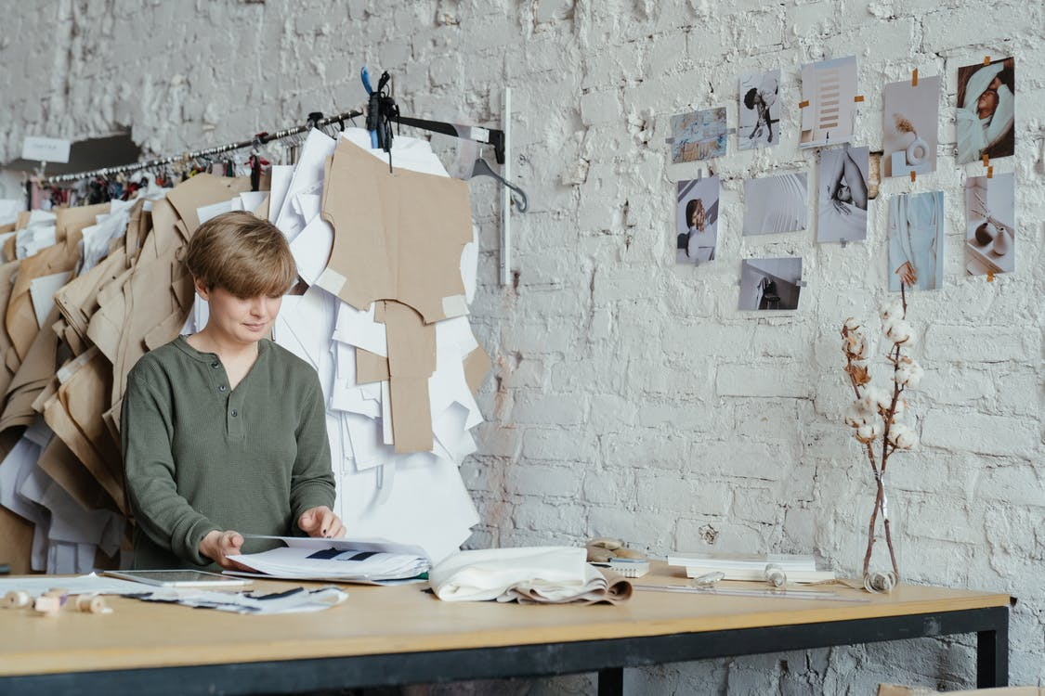
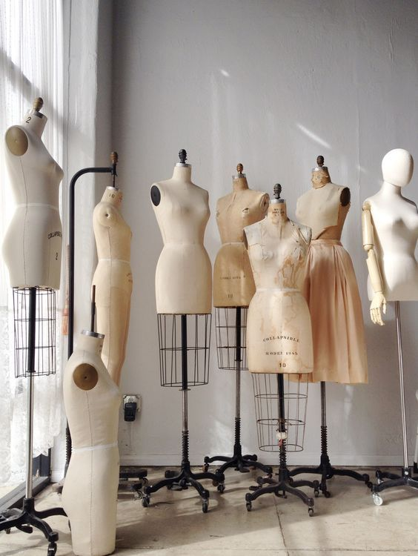
Introduction to pattern drafting and sewing
Source from royalty free photo from Pexels
⁽¹⁾
⁽³⁾
Source from royalty free photo from Pexels
Source from royalty free photo from Pexels

Slide 3
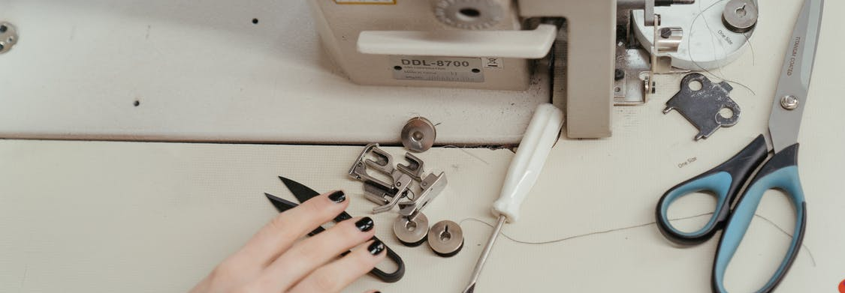
Safety Rules
Source from royalty free photo from Pexels

Slide 4
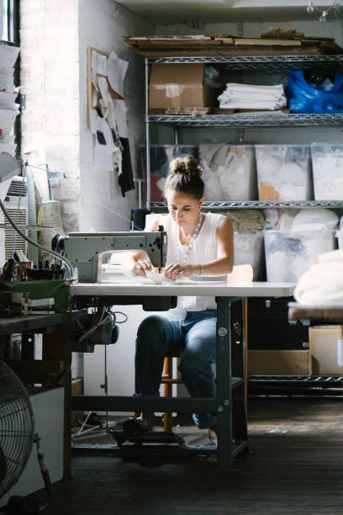
Feet should be removed from the treadle / foot pedal when not machining.
Treadle
Source from royalty free photo from Pexels

Slide 5
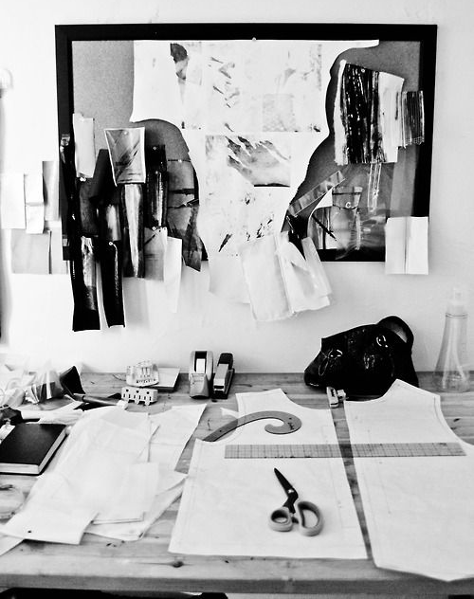
Scissors, needle and other sharp equipment should be handled with care and placed safely on worktops and tables.
Always keep fingers away from the needle and belt while the sewing machine is running.
Source from royalty free photo from Pexels

Slide 6
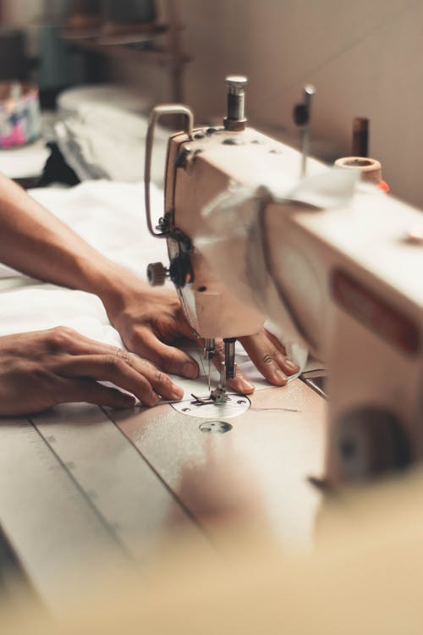
Long hair must be tied back.
Source from royalty free photo from Pexels
Source from royalty free photo from Pexels

Slide 7
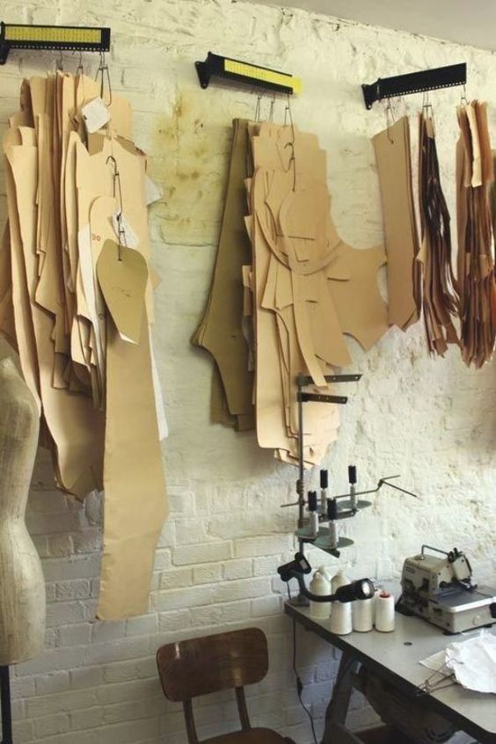
Never interfere with the motor or moving parts of the sewing machine.
Guards and other safety devices are there to protect the users and should not be removed.
Source from royalty free photo from Pexels

Slide 8
Tools and equipment for Making patterns

Slide 9
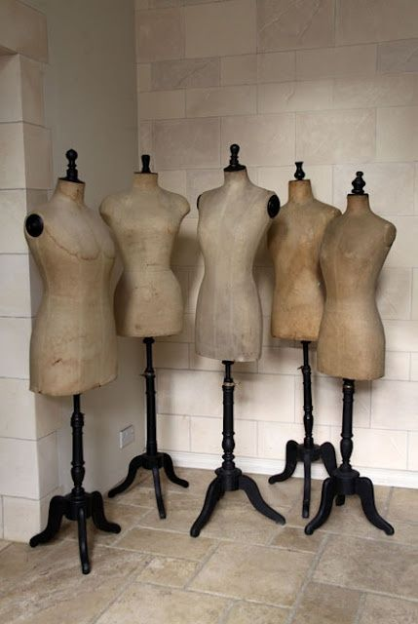
Dress stand
Source from royalty free photo from Pexels

Slide 10
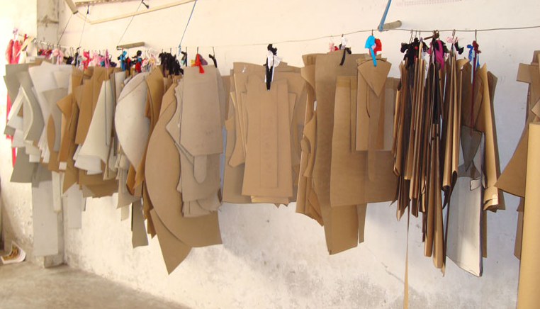
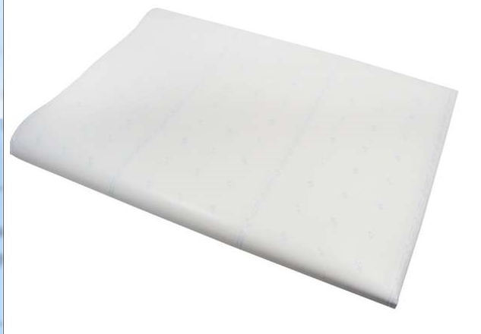
Paper (marker paper and Card board paper)
Source from royalty free photo from Pexels

Slide 11
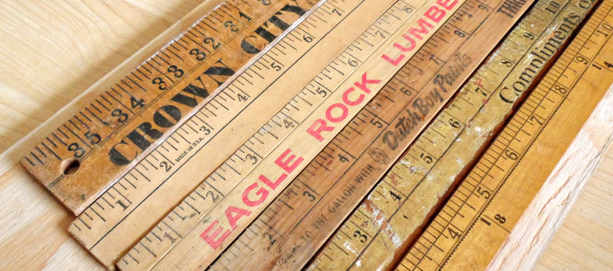
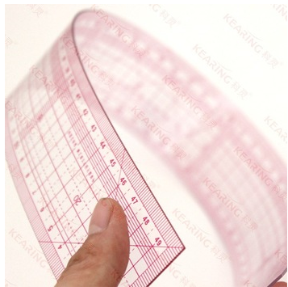
Tape measure/ Yard stick / Grading ruler
Source from royalty free photo from Pexels

Slide 12
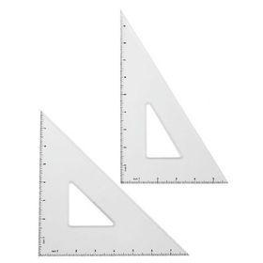
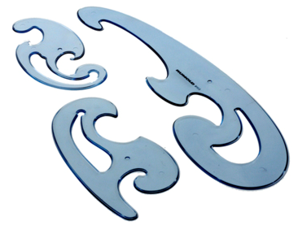
Set square / Curve rulers
Source from royalty free photo from Pexels

Slide 13
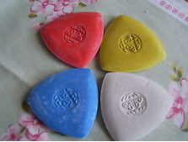
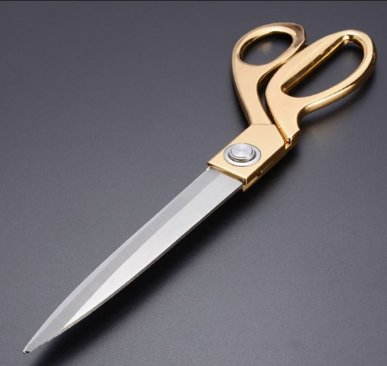
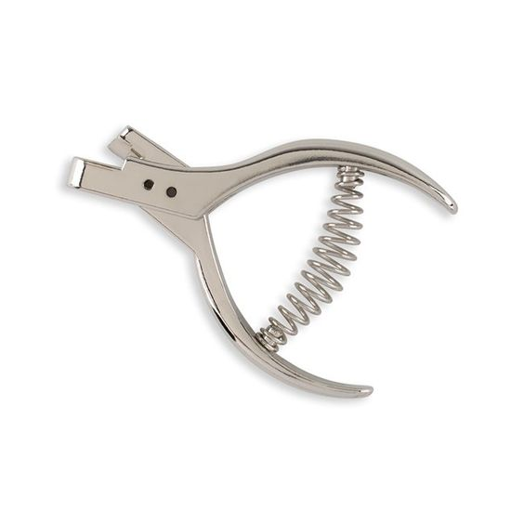
Pencil / Marking chalks / Cutting shears / Notcher
Source from royalty free photo from Pexels

Slide 14
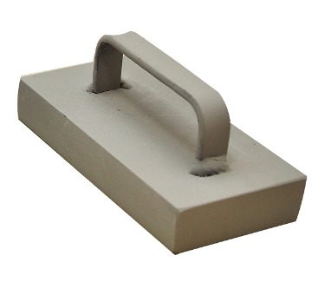
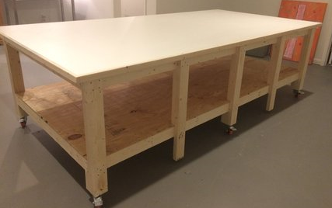
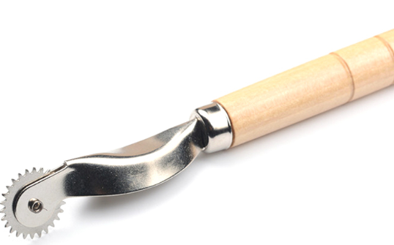
Tracing wheel/ Pattern weight / Work table
Source from royalty free photo from Pexels

Slide 15
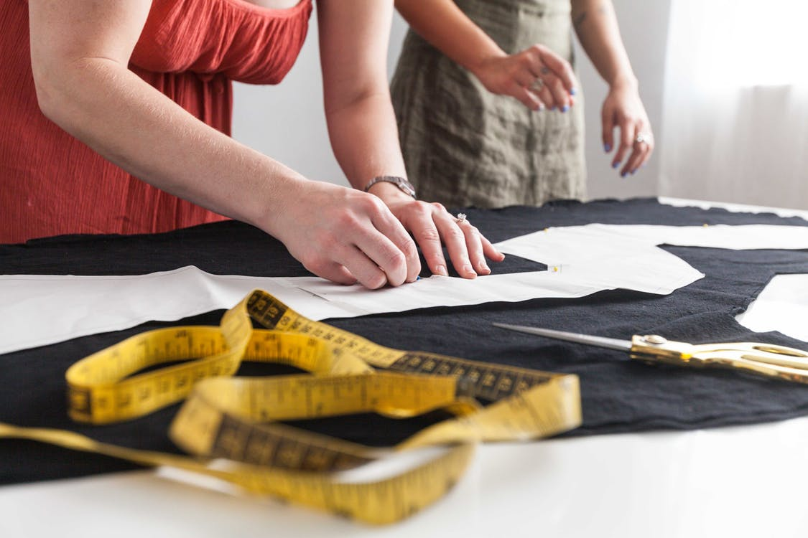
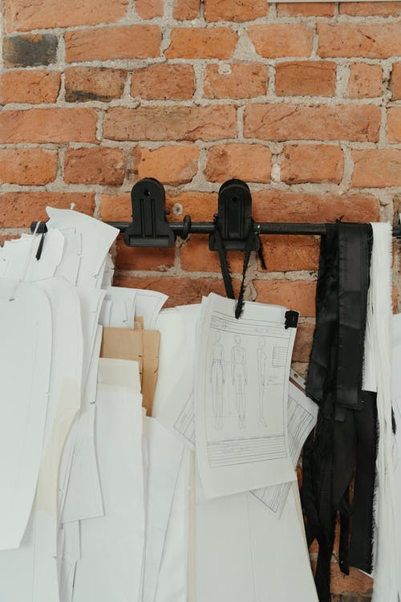
Introduction to pattern cutting techniques
Source from royalty free photo from Pexels
⁽¹⁾
⁽³⁾
Source from royalty free photo from Pexels

Slide 16
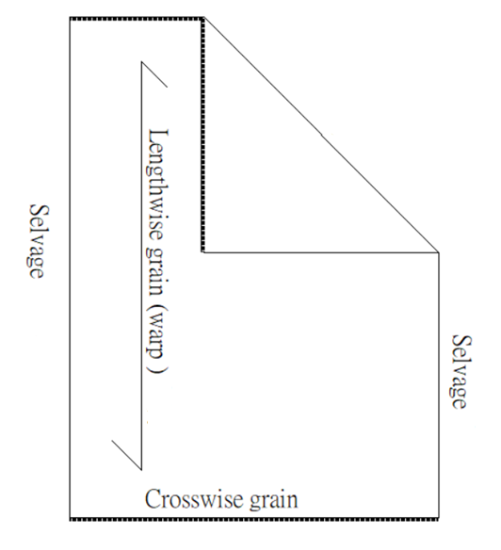
Grain Lines
Grain:
The direction of the yarn in woven fabrics. The direction affects the look feel of the fabric, and the hang and appearance of the garment.
Lengthwise grain (straight/warp ):
Yarns that are woven parallel with the selvage and twisted more tightly than the crosswise grain. Also called the straight grain.
Crosswise grain (cross/ weft):
Yarns that are woven perpendicular to the selvage.
True bias:
A diagonal line that intersects with the lengthwise and crosswise grains at a 45° angle. The bias has maximum stretch.
True bias
(45° angle)

Slide 17
Effects of different grain line positions on clothing design:
A ) Straight grain ( warp ) is stronger and stable. The straight grain can control the shape and hang of garment.
B ) Crosswise grain (weft) is woven perpendicular to the straight grain and is less stable.
C) True bias runs at 45° to the straight grain and crosswise grain, and causes fabric to stretch when cut.
A
C
B

Slide 18
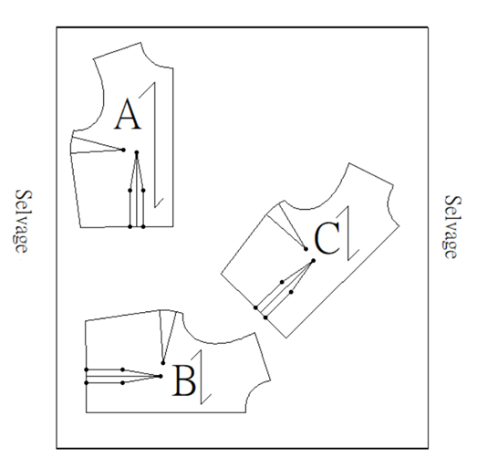
The Effect of Pattern's Grain on Fabric
The fabric’s grain can affect the appearance, hang, and fit of the garment.
The grain line on the pattern is always placed on fabric parallel with the selvage.

Slide 19
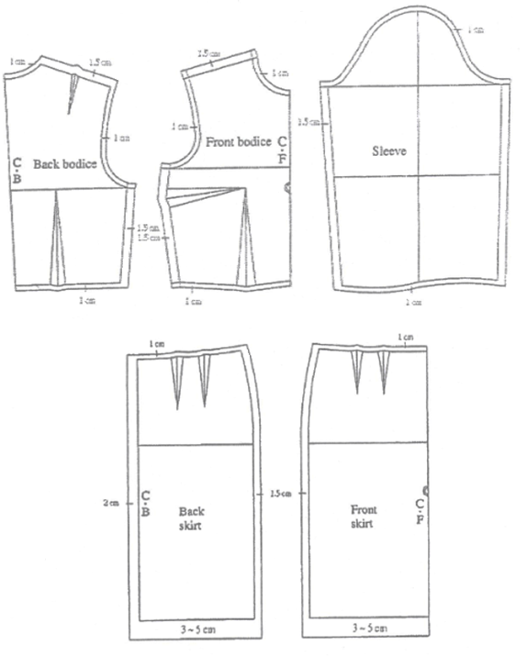
Seam allowance
Different areas / lines / curves add different amount of seam allowance
Curve line adds less seam allowance
Hem adds more seam allowance

Slide 20
Seam allowance
The amount of seam allowance varies according to the following factors:
Method of manufacture
Type of fabric
Type of style of garment

Slide 21
Notch
Indicates how different pattern pieces of a garment are matched to each other, as well as the placement of their darts, zippers, seam lines, hems and other design details.

Slide 22
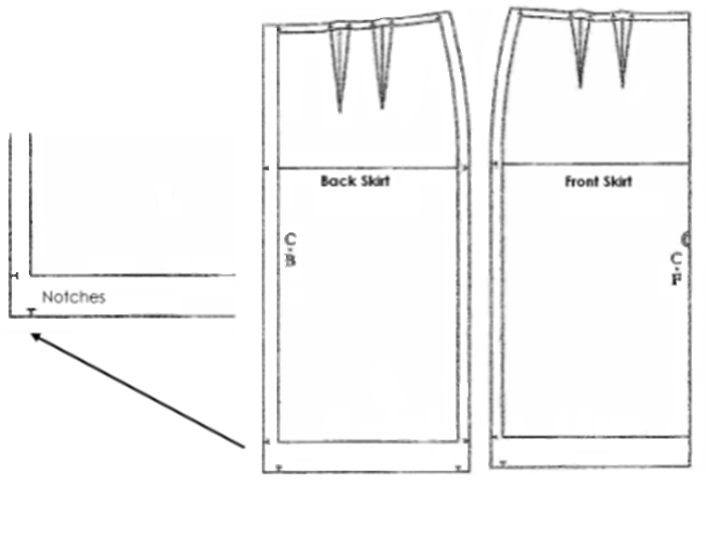
Notch
The marks are made inside the seam allowance at right angle to the seam line, and extend all the way to the pattern edge.

Slide 23
Balance Marks
They are used to ensure accurate joining of garment parts.
For example: two balance marks located at back armhole while one balance mark along front armhole.

Slide 24
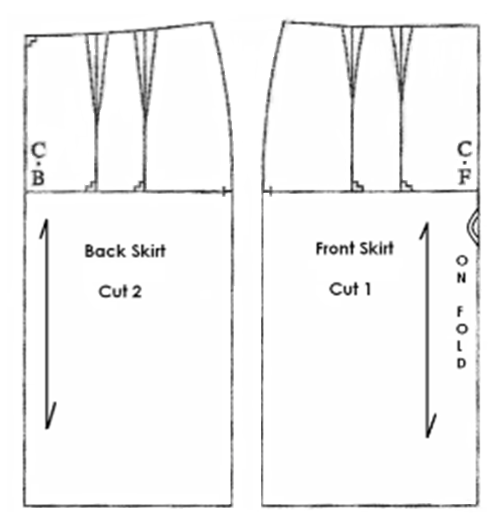
Labelling
Pattern pieces are labelled to indicate the pattern name, centre front, centre back and the total number to be cut.

Slide 25
Procedure for pattern construction
Stage One:
Analyse the designed style.
Draft / Trace basic blocks.
Adapt basic blocks to various garment styles.

Slide 26
Procedure for pattern construction
Stage Two:
Add appropriate seam allowance
Position the grain line, balance marks and notches
Label each pattern:
Name
Centre Front (C.F.) and Centre Back (C.B.)
Number of pieces to be cu
Type of fabric in which the pattern piece will be cut (e.g. lining)
Cut out pattern pieces

Slide 27
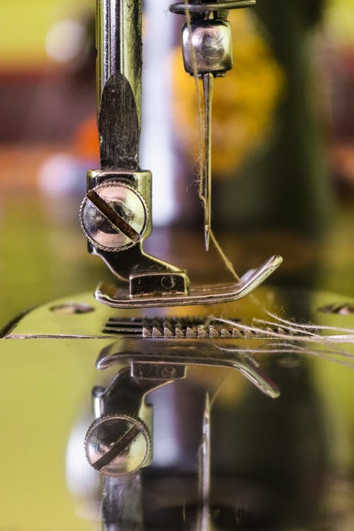
Preparation before sewing
Source from royalty free photo from Pexels

Slide 28
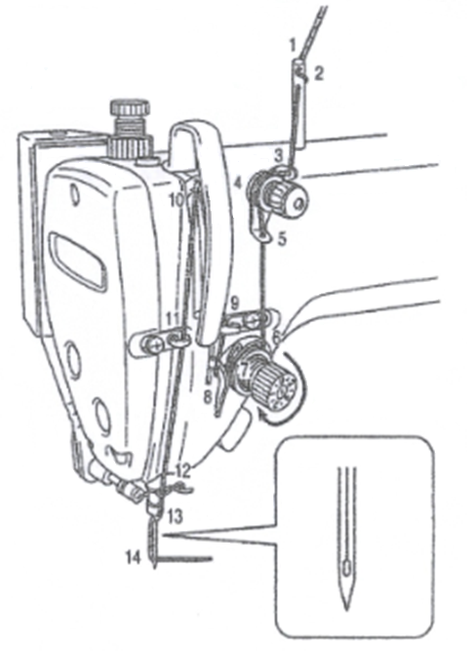
Preparation before sewing
Turn the machine pulley and raise the thread take-up before threading the upper thread
Pass the needle thread in the order shown in the figure.
Pass the thread to the needle eye from left to right.
Pull out about 10cm (4 inches) of the thread from the needle eye.

Slide 29
Operation the sewing machine
Turn off the power switch when threading the machine , replacing the bobbin or installing the needle.
Do not touch any of the moving parts or press any objects against the machine while sewing .
Switch off the power when not using the machine and when leaving the machine unattended.

Slide 30
Demonstration Videos
1. PREPARATION BEFORE SEWING - UPPER THREADING
2. PREPARATION BEFORE SEWING - BOBBIN AND BOBBIN CASE
3. PREPARATION BEFORE SEWING - THREAD THE BOBBIN

Slide 31
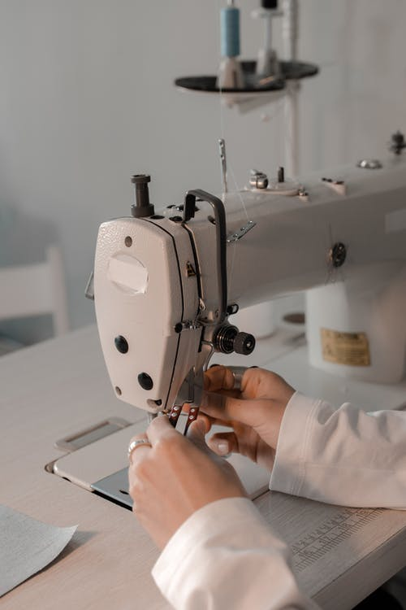
chapter activity
THREAD THE SEWING MACHINE
Can you try to thread the sewing machine and bobbin?
Source from royalty free photo from Pexels

